Slide 1
Syrian Emergency Task Force
Letters of Hope
Bringing Hope to Syrians

Slide 2
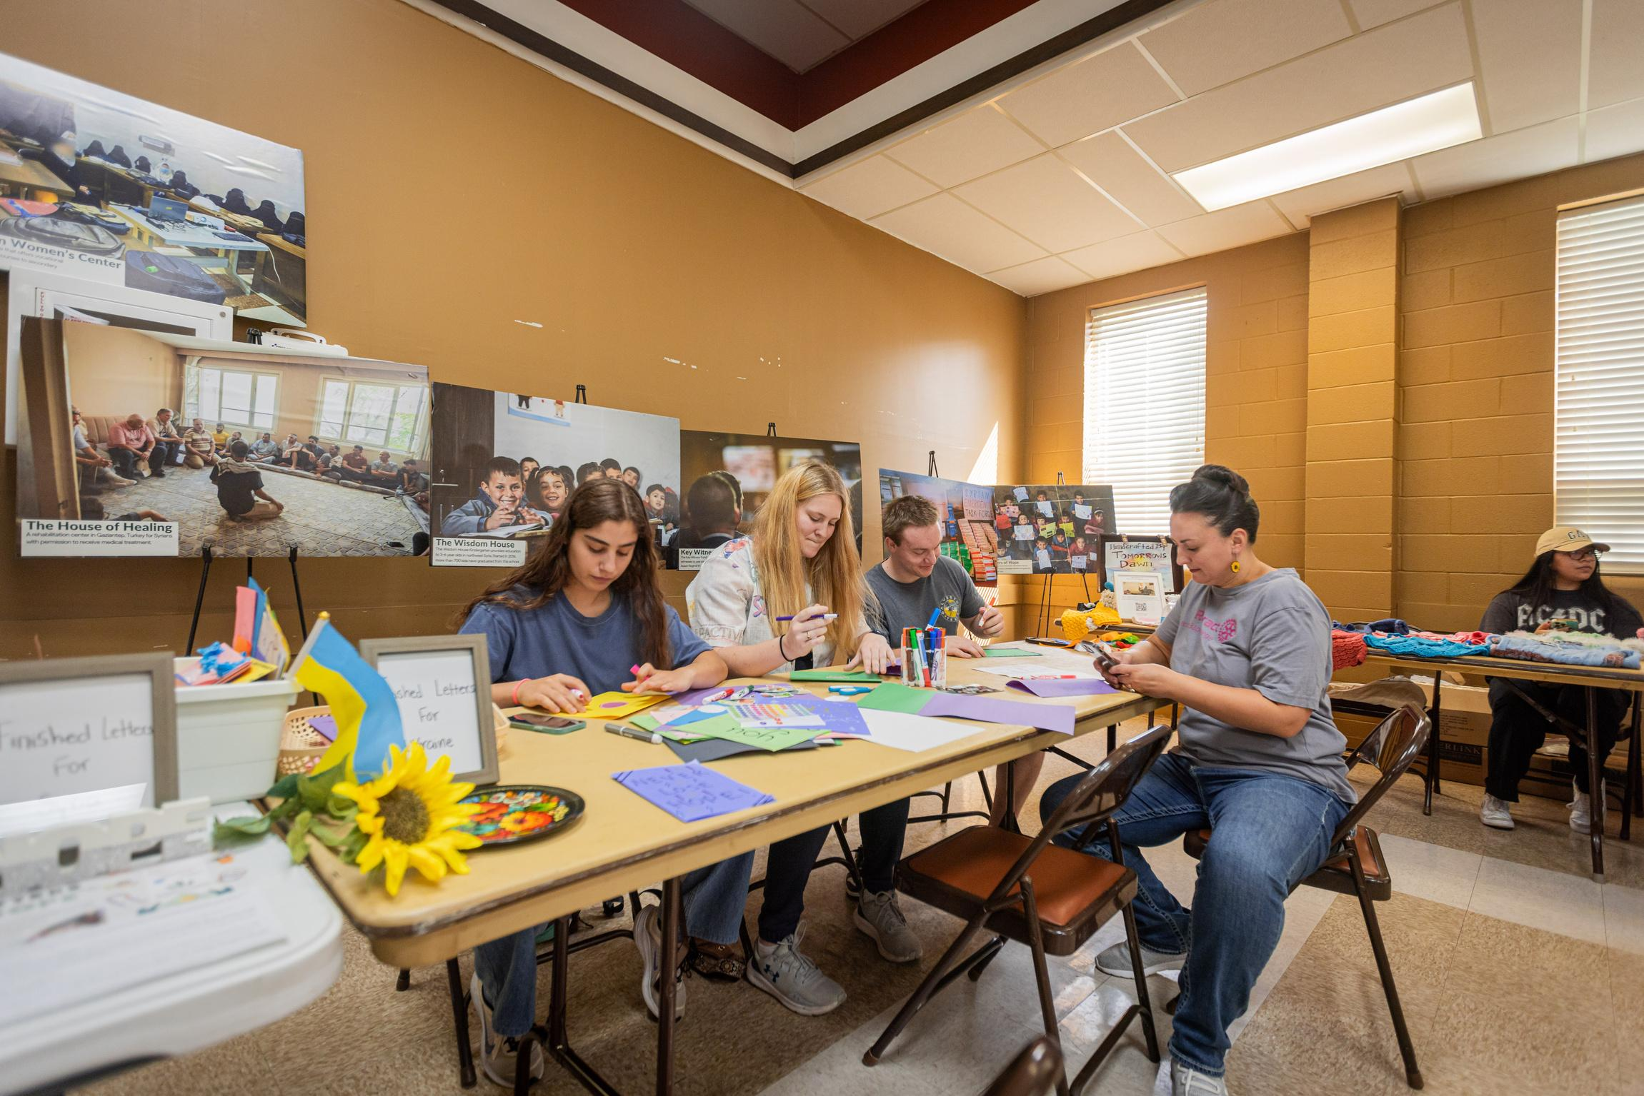
Introduction
The war in Syria has created a significant gap between displaced Syrians and the rest of the world.
Our initiative, Letters of Hope for Syria, aims to bridge this gap and let Syrians know they are not alone or forgotten.
This initiative has become one of SETF's prominent projects, inspiring hope and solidarity.
Watch this explanation of the origin of the Syrian war and an introduction to SETF in a video from M.Night Shyamalan, an American filmmaker and actor, who has become a pivotal supporter of SETF through his foundation.

Slide 3
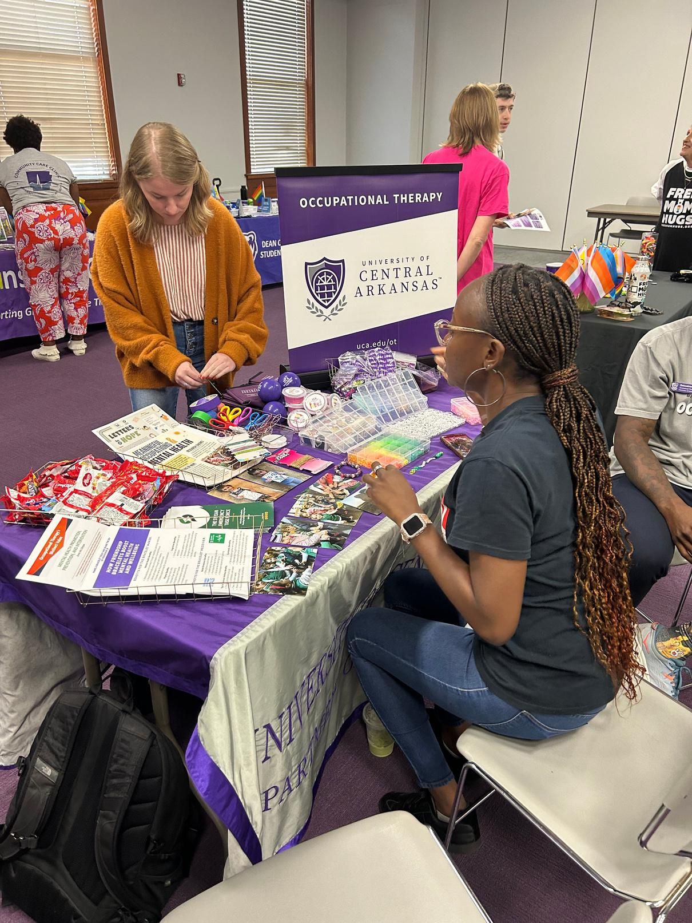
Impact
Our Letters of Hope initiative has been active in schools, universities, and houses of worship across the USA and the world.
Students are educating their peers about the Syrian war and the power of a simple letter of support.
FROM
MORE THAN
FROM
AND
2016
4000
13+
17+
LETTERS OF HOPE
COUNTRIES
US STATES

Slide 4
Who receives your letters?
SETF’s dedicated team members frequently travel from the U.S. to the Turkish/Syria border, personally delivering your letters and the digital ones to the beneficiaries of SETF’s humanitarian programs:
Wisdom House Kindergarten
Tomorrow's Dawn Women's Center
House of Healing Center
Rukban Camp Schools
And other humanitarian centers and schools in northwest Syria.

Slide 5
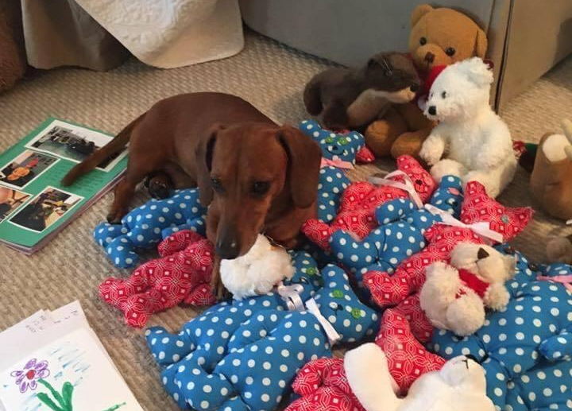
Crafting Your Message of Hope
Understand the Context
Familiarize yourself with the situation in Syria - SETF’s media resources.
Acknowledge the challenges faced by individuals.
Personal Touch
Share your name and where you're from.
Include a brief personal story or experience that connects you to their struggle.
Message of Hope
Offer words of encouragement and support.
Highlight resilience and strength in difficult times.
Positive Outlook
Share a positive quote or mantra.
Express your belief in a brighter future.
Closing
Sign off with warm wishes.
Include your first name or a friendly nickname.
Miko, Letters of Hope support volunteer
*The contents of your letters are completely up to your discretion. Our only guideline is that it emulates hope and does not include any triggering (i.e. dark, negative, violent, war, abuse) content.

Slide 6
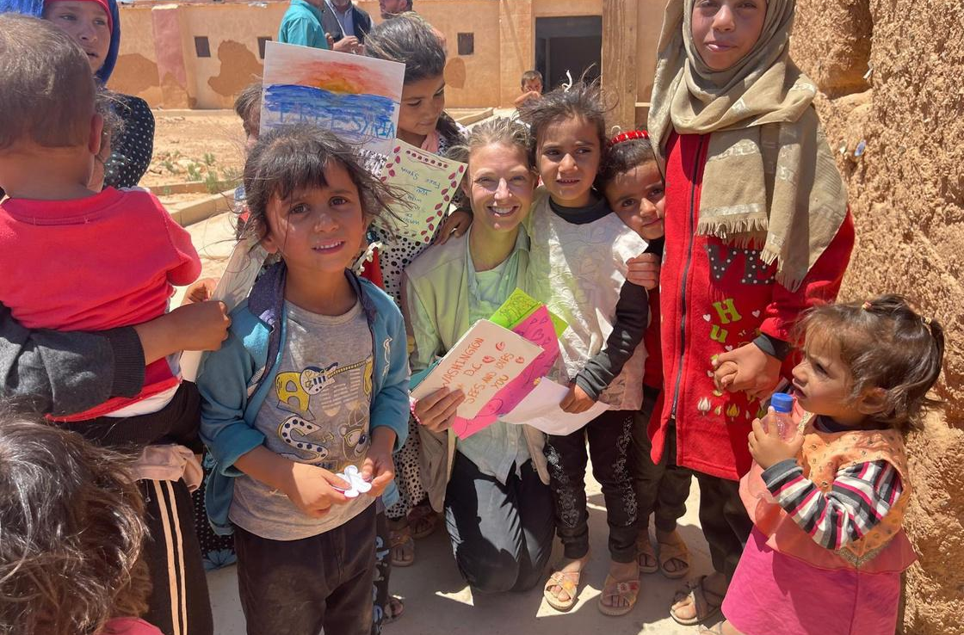
Contributing to the Program
How to Get Involved
Write a Letter
Follow the guidelines provided.
Submit your letter through mail or our online portal.
Spread the Word
Share this initiative on social media.
Encourage friends, family, and community to participate.
Organize letter-writing sessions
Volunteer Your Time
Join us for community events or workshops.
Help organize letter-writing sessions.
Donate
Consider making a financial contribution to support our programs.
Stay Updated
Follow us on social media for news and events.

Slide 7
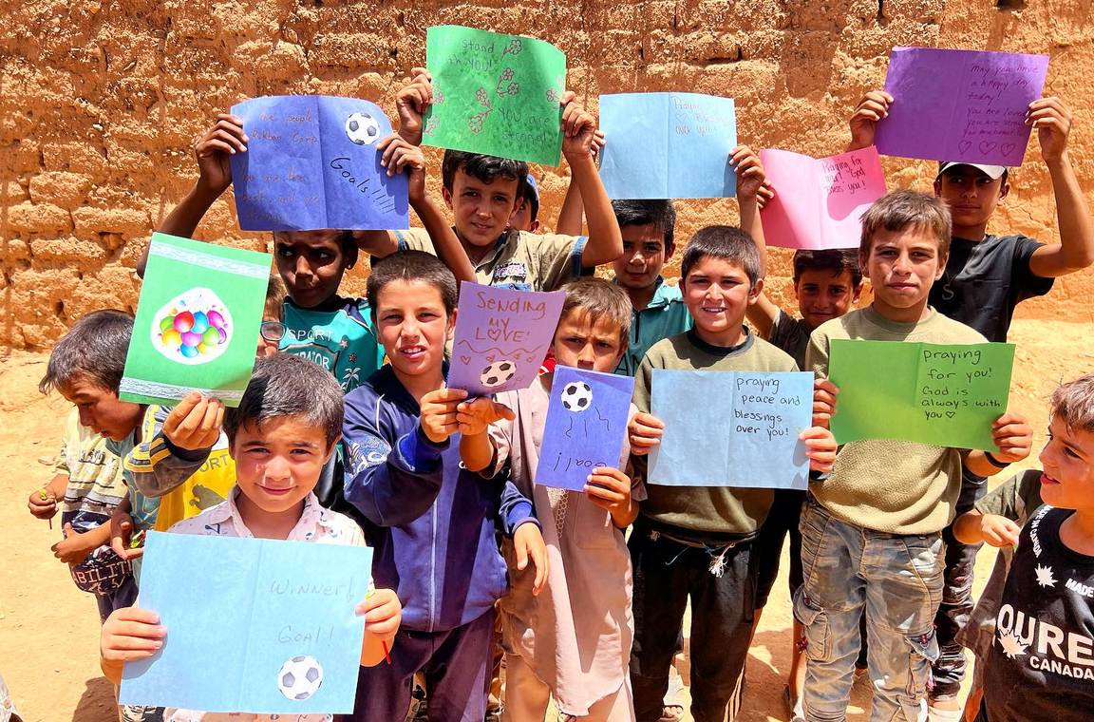
Sending Hope
Send your letter to:
PO Box 250972
Little Rock, AR 72225
Send your digital letters to:
setf.ngo/letters-of-hope

Slide 8
Our Social Media
https://setf.ngo/letters-of-hope/
@lettersofhopeforsyria
@lettersofhopeforsyria

Slide 9
Thank You

